Slide 1

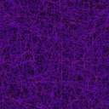
IOT-S26 (Smart Containers)
Graphic Era University , Dehradun
Professor: Mr. Kamlesh Kukreti Mentor 1 : Ranjith Kumar Bhupati
Student 1: Rishav Raj Chaudhary Mentor 2 : Arya
Student 2: Rahul Walia
Student 3: Saksham Dangwal
Student 4: Kritika Pandey

Slide 2
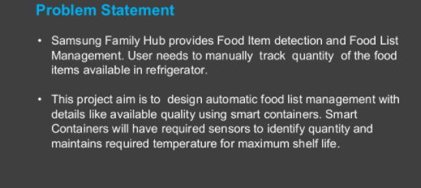
Problem Statement – Smart Containers(IOT-S26)

Slide 3
KPIs achieved till now
Studied research papers related with our project.
Learned about different microcontrollers to be used.
We practiced the Arduino board in simulator(proteus/Tinkercad).
Implemented programs for the implementation of sensor in simulator.
Created datasets that needs to be transferred to the mobile application.

Slide 4
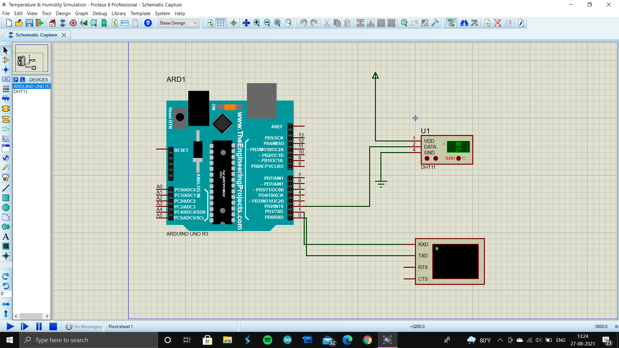

Slide 5
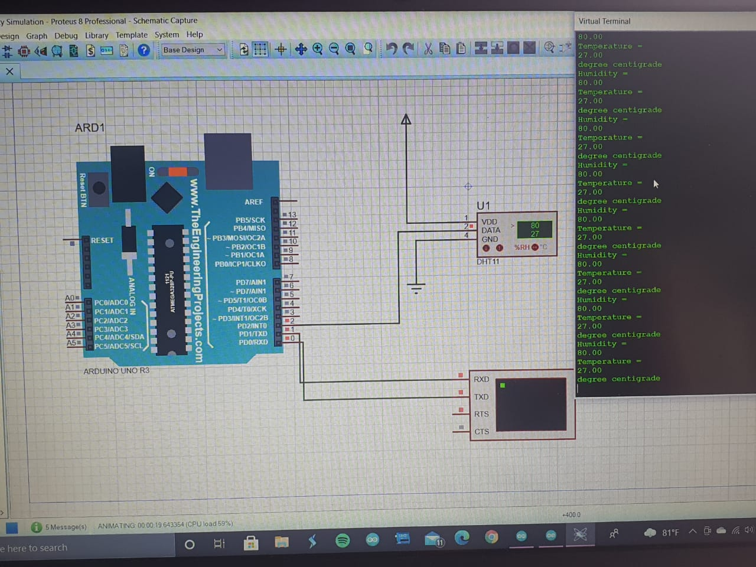

Slide 6
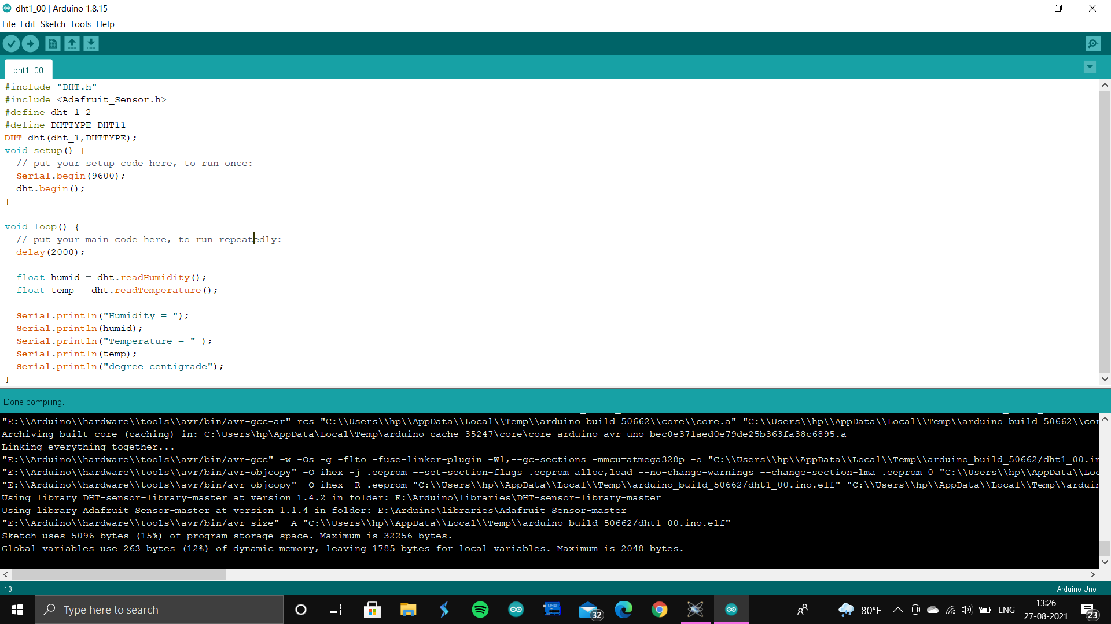

Slide 7
Challenges
The basic challenge we faced were the knowledge of electronic components like Arduino Uno R3 board,Sensors etc.
We faced problem in getting the idea of the simulation environment in Arduino.
All this were new to us Like we are the student of computer science and the working of electronic components were difficult to grasp.
Communication gap was the major challenge.

Slide 8
How we overcomed it
The best role played in clearing our doubts was of Kamlesh sir, he made us clear about the idea of working on different domains of project.
We also used youtube video tutorials on different topics.
We also used geeksforgeeks to learn about the libraries of Arduino and proteus software.
Communication gap was overcome by the MicrosoftTeams, we used video conferencing for interaction.

Slide 9
Next Steps
We will implement Communication between the simulator and mobile application via wifi/Bluetooth connection.
Create application.
Load datasets in the app for analysis.

